Slide 1
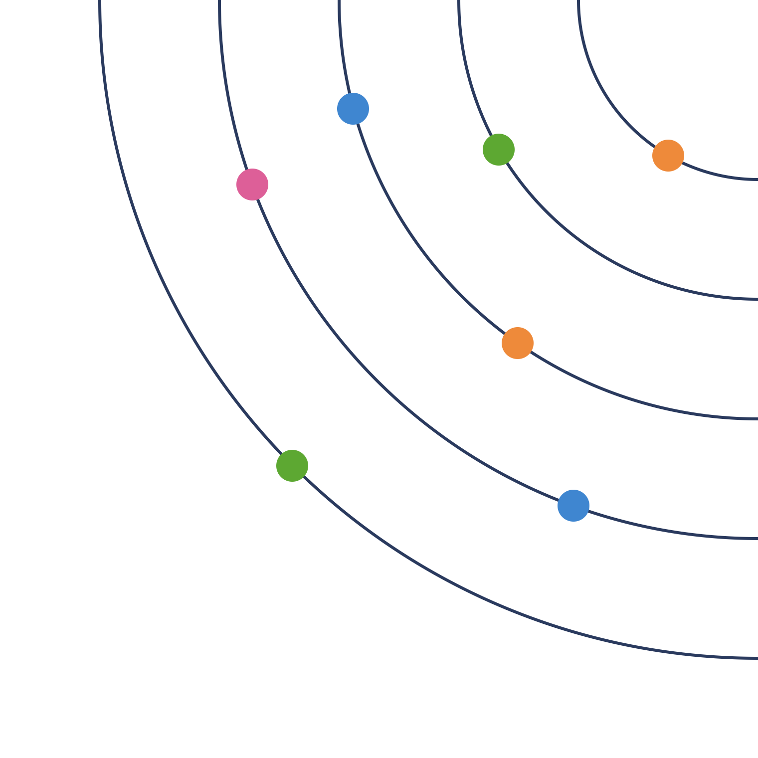
Building our sunray roadmap
TEAM WORKSHOP · INDIA ROBOTICS
2027–2030, aligned with the global Automation & Robotics roadmap
November 2026
Notes:
Welcome everyone. Today is not a review of anyone’s project. We are going to collect what we all work on, see how it fits the global roadmap, and build our own 4-year sunray roadmap together. Everything we produce today comes from you.

Slide 2
Three outcomes for today
WHY WE ARE HERE
1
2
3
Know where we stand
Align with global
Draft our sunray
Collect what each of us works on today, and for which plant stream.
See how our work fits the global A&R roadmap, and find the gaps.
Place our 2027–2030 topics on a sunray, with owners and skills.
India Robotics · Sunray workshop · 2
Notes:
Explain the three outcomes. Stress that the order matters: first we look at ourselves, only then at the global roadmap. The sunray at the end is a first draft that we will refine with the EU team.

Slide 3
Agenda for the day
THE PLAN
Morning
Afternoon
Time | Block
09:30 | Welcome and purpose
09:45 | Global roadmap at a glance
10:15 | Our focus areas and competencies
10:40 | What is a sunray element and a dot
11:00 | Break
11:15 | Board exercise · part 1
12:30 | Lunch
Time | Block
13:15 | Board exercise · part 2
14:30 | Update existing elements
15:15 | Break
15:30 | Place elements on the sunray
16:15 | Review: gaps, links, owners
16:45 | Close and next steps
17:00 | End
India Robotics · Sunray workshop · 3
Notes:
Times are a guide. If you run two half-days instead, end day one after board exercise part 1 and start day two with part 2. Keep a visible timer running for every block.

Slide 4
Our four years sit in the “mature” phase
GLOBAL ROADMAP AT A GLANCE · PHASES
2022–2026 · “by Airbus”
2026–2030 · “by Airbus for Airbus”
2030–2036 · “mastered by Airbus”
Demonstrate & develop
Mature & pre-industrialise
Integrate & roll out
Proofs of concept, stand-alone stations, TRL3–6 demonstrators.
Co-design with launch plants, mature in PIAs, in-process inspection and native digital continuity.
Full eAction Future Industrial System across plants and FALs.
Ends at the β gate
EIS 2032 · rate 80 by 2035
Ends at the A gate, 2030
India sunray: 2027–2030
Source: “Building the Future Industrial System” slide · 4
Notes:
Key message: our 4-year roadmap (2027–2030) falls exactly inside the global “Mature and pre-industrialise” phase. So our main job is to help technologies become industrially ready before the 2030 A gate, not only to make new demos. PIA means Pre-Industrial Accelerator.

Slide 5
Six pillars hold up the future factory
GLOBAL ROADMAP AT A GLANCE · PILLARS
Future factory, ready by 2030 · the global ambition
1 · Standard machines
2 · AI everywhere
3 · Step by step
4 · Automate processes
5 · Data flows
6 · People first
Transversal AI
Maturity gateways
Digital continuity
Human-centric
Modular product lines
Vision, monitoring and automated decision making.
Lab demo, then plant trial, then production.
End-to-end automation
CAD data goes straight to the robot.
Robots take heavy work; people supervise.
Build once, reuse in many plants.
Automate whole chains, not single tasks.
e.g. robot path made from CAD, no hand teaching
e.g. camera finds a hole, robot corrects itself
e.g. sealing: TRL4 in lab, MRL6 in trial
e.g. one operator supervises several cells
e.g. MSDR drilling robot in every plant
e.g. drill, seal and inspect in one flow
Next slide: the scoreboard. Eight targets show whether the pillars work.
Source: global A&R roadmap summary · 5
Notes:
Use the picture of a building. The roof is the global ambition: a future factory, ready by 2030. The six pillars hold it up. For each pillar, read the plain name, then the example. 1, standard machines: build once and reuse, like the MSDR drilling robot. 2, AI everywhere: vision, monitoring and automated decision making, like a camera finding a hole and the robot correcting itself. 3, step by step: lab, then plant trial, then production. 4, automate whole process chains, not single tasks. 5, data flows: CAD data goes straight to the robot. 6, people first: robots take the heavy work and people supervise. The bar at the bottom leads into the next slide: the scoreboard.

Slide 6
The scoreboard: eight global targets
GLOBAL ROADMAP AT A GLANCE · TARGETS
−95%
−40%
−50%
−28%
Fuselage rigging cycle time
Finishing cycle time
Recurring cost (up to)
Paint line floor space
Joining the fuselage is much faster
Sanding and sealing take less time
Each aircraft costs less to build
Paint shops need less space
>95%
Real time
7→30%
−50%
Data accuracy
Defect detection
Tasks done by robots and AI
Ergonomic risk (at least)
Factory data is correct and traceable
Defects are found during the work
Machines do much more manual work
Less heavy or unsafe work for people
Every element should support a pillar and move one of these targets: its business impact · 6
Notes:
These are the numbers the global team uses to check whether the pillars work. A minus sign means “reduce by”. Read each big number with its plain meaning. Then the key message at the bottom: in the workshop, every element should answer two questions. Which pillar does it support (previous slide)? Which target does it improve (this slide)? The answer to the second question goes into the Business impact field of the element sheet. Example: adaptive drilling supports pillar 1, because it runs on the standard MSDR, and improves recurring cost through less rework.

Slide 7
Our eight focus areas, in global words
OUR FOCUS AREAS
Our focus area | Matching global terms
Vision & perception | AI Perception
Motion & task planning | Embodied AI, Intelligent Scan & Plan, programless deployment
Robot & adaptive control | Hardware abstraction layer, intelligent control, MSDR / Flextrack / end effectors
Process & quality | Intelligent monitoring, predictive quality, in-process inspection
RXU software platform | Generic software stack, model zoo, AI for development
Data & connectivity | Digital continuity, TRUSTME, iEdge, MLOps
Simulation & digital twin | Intelligent simulation, virtual commissioning
Trust, safety & security | Trustworthy AI, ergonomic safety, EU AI Act
India Robotics · Sunray workshop · 7
Notes:
These are our eight focus areas, as a draft the team can rename, merge or extend. Message: we are not inventing a separate world. Each of our pillars already has a matching name in the global roadmap. Using the global words in our sunray makes alignment visible to the EU team.

Slide 8
Competencies each group needs
OUR FOCUS AREAS · COMPETENCIES
Intelligent robot
Software & data
Process & quality
Virtual & trust
Image processing, 3D point clouds
Deep learning for vision
Path planning, kinematics
Force and torque control
FANUC and UR controller interfaces
Software architecture, C++ and Python
Middleware and interfaces
DevOps and automated testing
OPC UA, industrial networks
MLOps and databases
Process physics: drilling, sealing, painting
Data science and machine learning
Statistical quality
In-process inspection
Robot and physics simulation
Virtual commissioning
Machine and cobot safety
Cybersecurity
Trustworthy AI, certification
A starting list. Each element names the competencies it needs · 8
Notes:
Do not discuss each skill now. Just show that every focus area needs its own skills. Competency is one of the five dimensions of every element, so the team will name the skills each element needs, and whether we must build, hire or get them from partners.

Slide 9
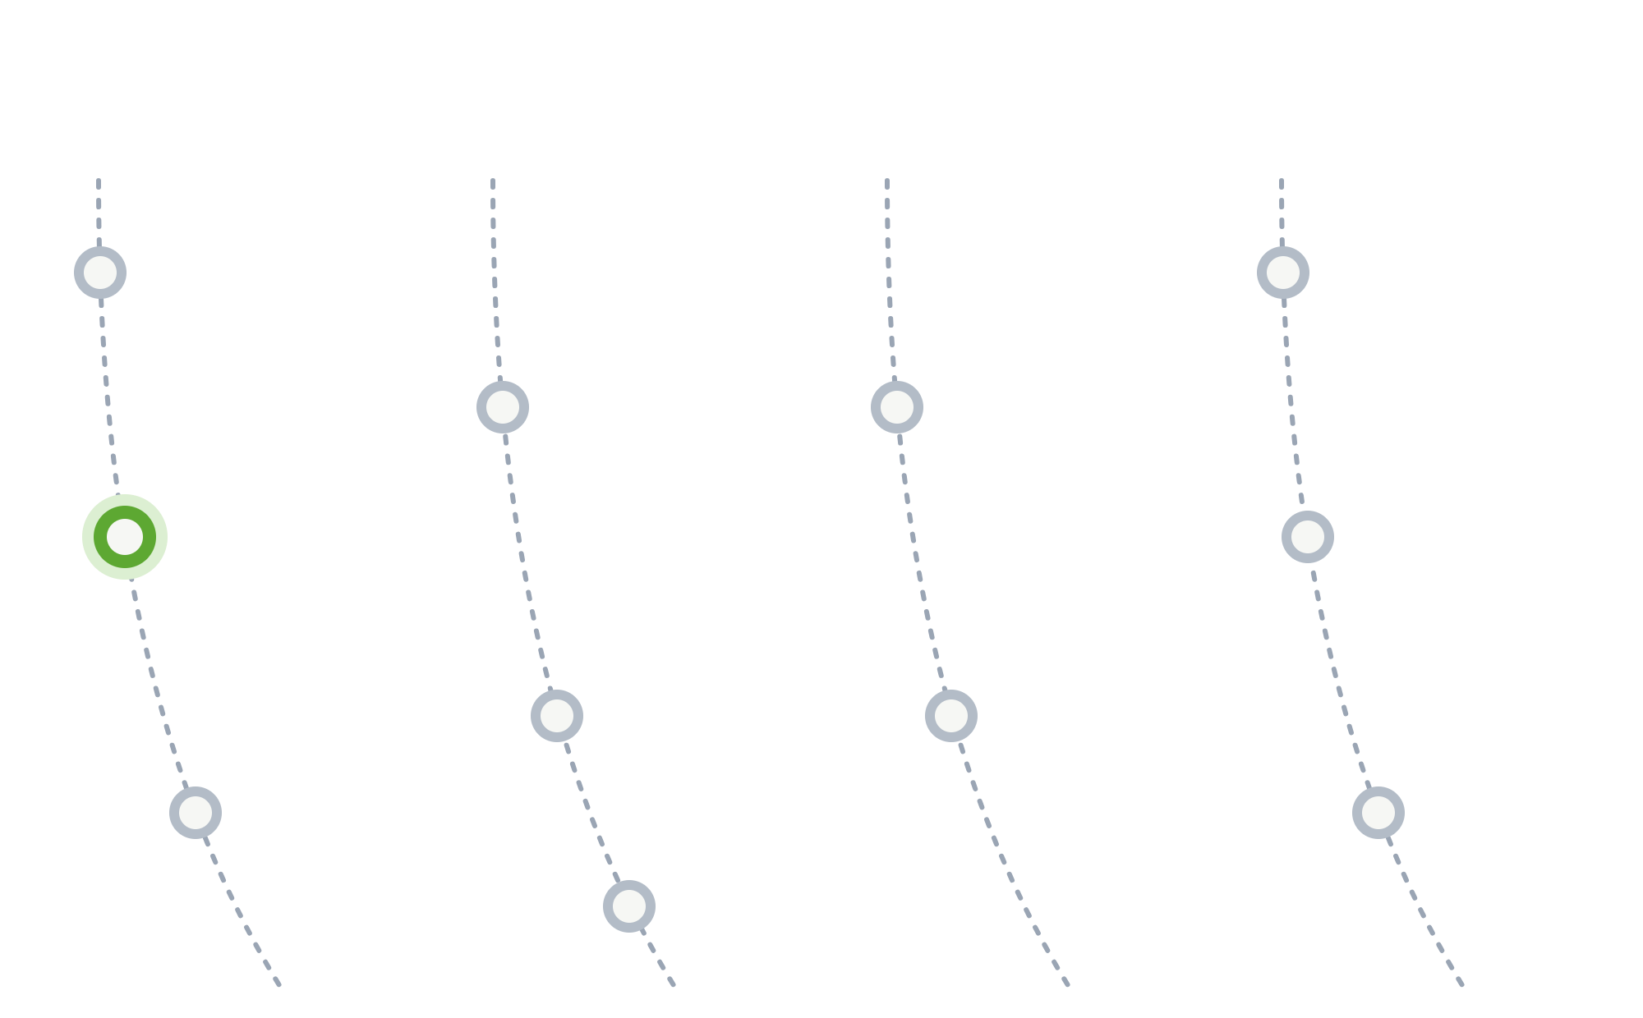
How to read a sunray
BEFORE THE EXERCISE · READING A SUNRAY
2027
2028
2029
2030
An arc is a year
Each dotted arc is one year, from 2027 to 2030.
A dot is an element
Each dot is one roadmap element, placed on the year it should be ready.
The colour is the category
Robotics
digital twin
All robotics elements share one colour. Other categories have their own.
Element vs dot: the element is the full description of Robotics digital twin (next slide). Its dot is only its place: green, on the 2027 arc.
Illustrative sunray, not the department sunray · 9
Notes:
Do not show the department sunray here, so the team is not biased by it. Explain with this example only. An arc is a year. A dot is one element, placed at its target year. The colour shows the category. Robotics digital twin is an existing robotics element in the department sunray, targeted for 2027, so it appears as a green dot on the 2027 arc.

Slide 10
Example: Robotics digital twin
BEFORE THE EXERCISE · EXAMPLE ELEMENT
Element & dimensions | Example
Element name | Robotics digital twin
Owner (SME) | [name]
Workstream | [workstream]
Target year · priority | 2027 · [priority]
Competency | Robot simulation, kinematics, software
Component | Virtual model of the robot cell
Program | [aircraft line or plant]
Business impact | Test robot programs before the hardware is ready
Roles | Simulation and robotics engineers
Status, scope & steps | Example
Current status | [e.g. proof of concept]
Problem | Robot programs are tried on real hardware: slow and risky
Solution | A virtual robot cell to test paths and layouts first
Skills required | [e.g. 1 simulation engineer]
Phase 1 | Model of one robot cell · [date]
Phase 2 | Link the model to real robot data · [date]
Linked elements | [elements it depends on]
Illustrative values; [brackets] are to fill. Replace with the real element sheet before the workshop · 10
Notes:
This shows what an element is: its full description in the element sheet. The green rows are the five dimensions every element answers. The sheet also has resource needs, roadmap phases, linked elements and documents. Before the workshop, replace these illustrative values with the real content of the Robotics digital twin element from the department sheet, so the example is accurate.

Slide 11


Two cases, two ways to capture
BEFORE THE EXERCISE · EXISTING OR NEW?
YES
Update the existing element
ASK FIRST
Open its element sheet in Excel and update the status, steps, target year and links.
Is this topic already an element in the department sunray?
NO · most robotics topics
Create a new element
Capture it in today’s board exercise, then fill a new element sheet.
Most robotics topics are not in the department sunray yet, so most of our work today creates new elements.
India Robotics · Sunray workshop · 11
Notes:
This is the hand-over to the board exercise. If a topic already exists as an element in the department sunray, we do not create it again: the owner updates the existing element sheet in Excel. If it is new, which is the case for most robotics topics, we capture it in the board exercise and then fill a new element sheet. Now explain the board exercise.

Slide 12
Capture each new element on the board
BOARD EXERCISE · HOW TO FILL IT
BUSINESS BRICK NAME
ENVISIONED ROLE
1
One colour = one element. Use the same sticky colour in every block.
Adaptive drilling
[Element 2]
Robotics engineer
[role]
2
Business brick: the name of the element.
3
Envisioned role: who will do this work.
COMPETENCY
PROGRAM
4
Competency: the skills it needs.
Force control
Kinematics
[skill 1]
[skill 2]
[program or plant]
[program]
5
Program: which program or plant it serves.
6
Roadmap steps: phases 1 to 4, one sticky each, with a year.
Phase 1 · 2027
Lab demo
Phase 2 · 2028
Plant trial
Phase 3–4
[step · year]
7
Collaborative brick: other elements it works with or depends on.
ROADMAP STEPS
Each brick = one new dot, placed at its target year. Other details go into the element sheet afterwards.
COLLABORATIVE BRICK
Robotics digital twin
+ add another
Board format 1 · example values, [brackets] are to fill · 12
Notes:
Show how one element travels across the board. The yellow stickies all belong to one element, Adaptive drilling: its name in Business brick, the role in Envisioned role, its skills in Competency, its program in Program, its phases with years in Roadmap steps, and the elements it works with in Collaborative brick. A second element uses a second colour, here pink. Every business brick on the board becomes one new dot on the India sunray. The phases show its target year, which places the dot on the sunray. The rest of the details are added later in the element sheet. Adaptive drilling is only an example; replace it with a topic from the team if you prefer.

Slide 13
From today to our roadmap
CLOSE · AFTER TODAY
1
2
3
4
5
Collect the board results
Fill an element sheet for every element
Place each element as a dot on the sunray
Review it with the EU team
Check progress every quarter
One overview of all elements
Element | Owner | Workstream | Target year | Priority | Status | Competency
Robotics digital twin | [SME] | [workstream] | 2027 | [ ] | [status] | Simulation
Last round: “Which element will you own?”
India Robotics · Sunray workshop · 13
Notes:
Explain what happens next and when. Go round the room: each person says in one sentence which element they will own. Thank everyone; the sunray is their work. Within one week, share the board results and the filled element sheets with the team.

